Slide 1


Diabetes Prediction using SVM
By:Bhavyanshu Srivastava
Sec –CSE

Slide 2
Introduction
This project aims to develop a system that can effectively predict the likelihood of diabetes in individuals using the support vector machine (SVM) algorithm. The system leverages machine learning techniques to analyze relevant patient data and generate accurate predictions, providing valuable insights into potential health risks.
The motivation behind this project is to keep people aware about their health. Normally, people go to doctors for their health checkup. By developing this tool for the users, making it easier for users to test and understand their health at home without wasting money.

Slide 3
- Python: Python is an interpreted, object-oriented, high-level programming language with dynamic semantics. Its high-level built in data structures, combined with dynamic typing and dynamic binding, make it very attractive for Rapid Application Development.
- SVM: A support vector machine (SVM) is a supervised machine learning algorithm that classifies data by finding an optimal line or hyperplane that maximizes the distance between each class in an N-dimensional space.
- Numpy: NumPy is a Python library used for working with arrays.It also has functions for working in domain of linear algebra, fourier transform, and matrices.
- Pandas: Pandas (styled as pandas) is a software library written for the Python programming language for data manipulation and analysis.

Slide 4
METHEDOLOGY
Data Preprocessing: Cleaning the data by handling missing values, normalizing numerical features, and splitting the data into training and test sets.
Feature Selection: Identifying the most significant features that contribute to the prediction.
Model Training: Using the training set to train the SVM model.
Model Evaluation: Evaluating the model using the test set with metrics such as accuracy, precision.

Slide 5
Data Preprocessing
Missing Value Imputation
Missing values in the dataset are handled using appropriate techniques. These techniques could involve deleting rows with missing values, replacing them with mean or median values, or using more sophisticated imputation methods.
Normalization
Numerical features are normalized to ensure they are on a similar scale. This prevents features with larger values from dominating the model's learning process. Common normalization techniques include min-max scaling and standardization.
Data Splitting
The preprocessed dataset is split into training and test sets. The training set is used to train the SVM model, while the test set is used to evaluate its performance on unseen data.

Slide 6
Feature Selection
From the preprocessed data, significant features that contribute to diabetes prediction are identified. This step is crucial for building a robust and efficient model.

Slide 7
Model Training And Evaluation
Model Training | The SVM model is trained using the training data. This involves finding an optimal hyperplane that separates diabetes cases from non-diabetes cases.
Model Evaluation | The trained SVM model is evaluated using the test data. Metrics such as accuracy, precision, and recall are calculated to assess the model's ability to predict diabetes correctly.

Slide 8
Conclusion
The project successfully developed a diabetes prediction system using the SVM algorithm. The system can effectively analyze patient data and generate predictions.
The system has the potential to contribute to improved healthcare outcomes by facilitating early detection

Slide 9
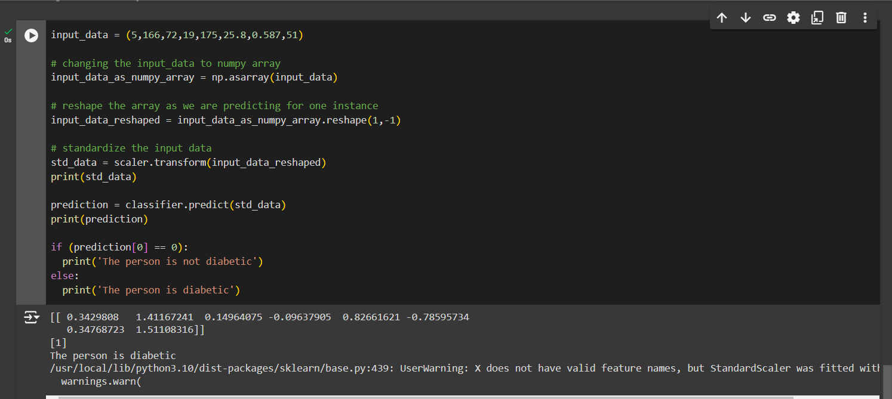
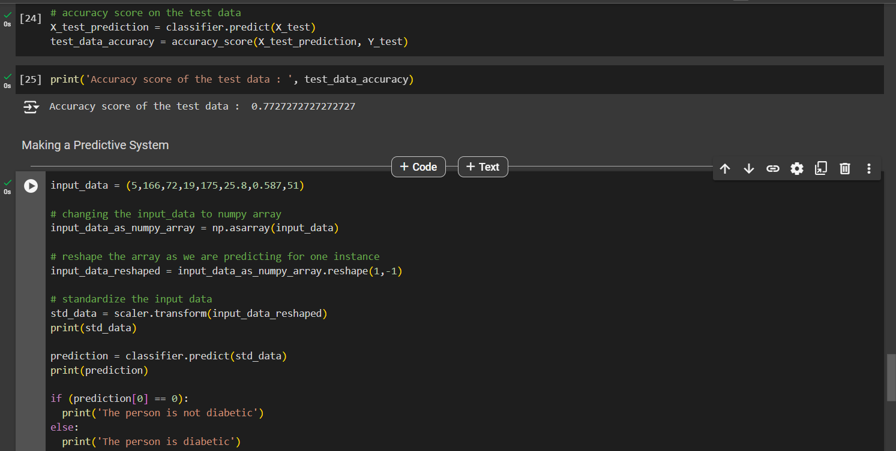
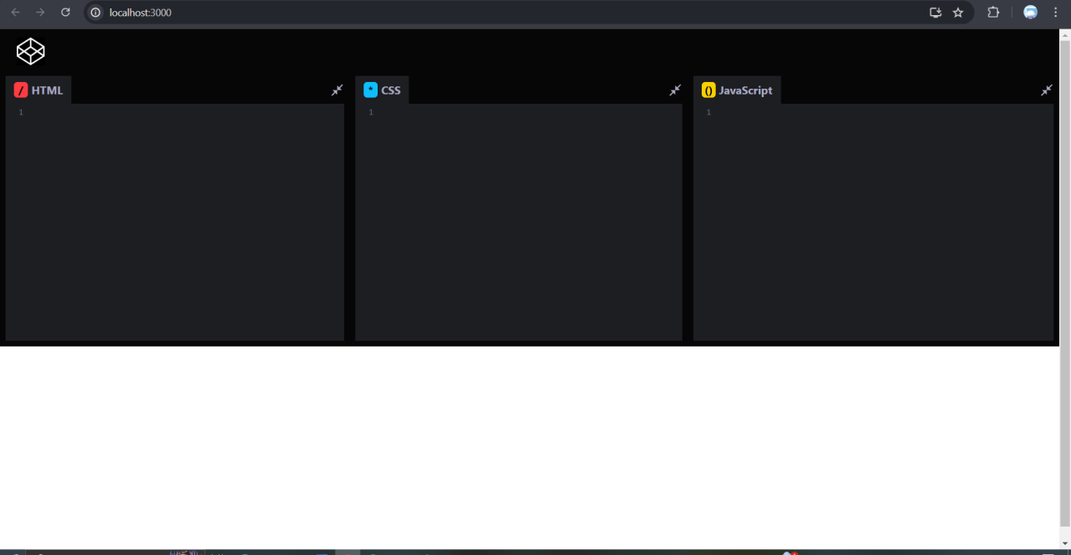
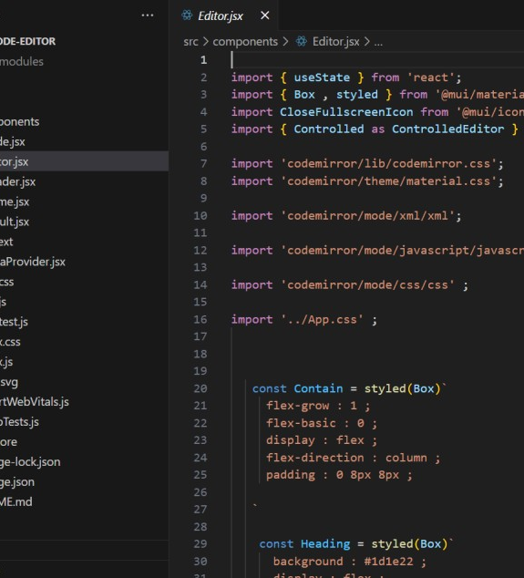
Result

Slide 10
THANKYOU

